Slide 1
Raleigh RedHawks 2018
Season review

Slide 2
Raleigh RedHawks 2018 Season Review
ONE CLUB, ALL IN
THE TEAM TOWERS OVER THE INDIVIDUAL

Slide 3
Raleigh RedHawks 2018 Season Review
Agenda For the Evening
· Welcome and Opening Remarks--Dave Krosner
· Touch Team Presentation--Chris Travis and Andrew Wharton
· Overall Season Accomplishments—Andy Thomas
· 5/6 Team Presentation—Byron Engelbrecht
· Middle School Team Presentation—Ivan Morton (and MS Coaches)
· High School Team Presentation--- JV--Toby Dickens; Varsity—Andy Thomas and Dave Krosner
· Our Graduating Seniors—High School Coaches
· Closing Remarks and Summer Events—Dave Krosner, Toby Dickens and Andy Thomas

Slide 4
Raleigh RedHawks 2018 Season Review
Touch Program
Chris Travis
Andrew Wharton

Slide 5
U8 Touch Program

Slide 6
U10 Touch Program

Slide 7
Raleigh RedHawks 2018 Season Review
Team Accomplishments
STATE CHAMPIONS!
Middle School State Champions
High School State Champions
Ruggerfest winners – Middle School
Undefeated Gonzaga – 9th, JV and Varsity (2 year in a row-undefeated)
-Varsity game -RedHawks 38 - Gonzaga Varsity Black 10
- RedHawks JV 29- Gonzaga JV 5
-RedHawks Freshman 34-19 Gonzaga Freshman
Strong showing in the Jesuit Tournament

Slide 8
Raleigh RedHawks 2018 Season Review
Individual Accomplishments
Evan Thomas selected to play for USA South in RAN
-Capped against Mexico, Jamaica and Turks and Caicos
Nate Roeback, Nahuel Wingord and George Obrien
-All selected for EIRA tour of Canada

Slide 9
Raleigh RedHawks 2018 Season Review
Individual Accomplishments
USA South Selection Las Vegas
18U Team’s Elite Tomas Alvarez Evan Thomas
U18 Team Open Kris Thomas
16U Team’s Christian Dickens Nahuel Wingord
14U Team’s Zach Piepho Nathan Wastie Matthew Doyle Grady Steele (and former Redhawk player—Austin Taillon)
U18 Tennessee Tri-Star LVI Team Tate Phillipson George O'Brien

Slide 10
Raleigh RedHawks 2018 Season Review
Middle School State Champions

Slide 11
Raleigh RedHawks 2018 Season Review
Ruggerfest Champions Middle School

Slide 12
Raleigh RedHawks 2018 Season Review
Our Fabulous Touch Program

Slide 13
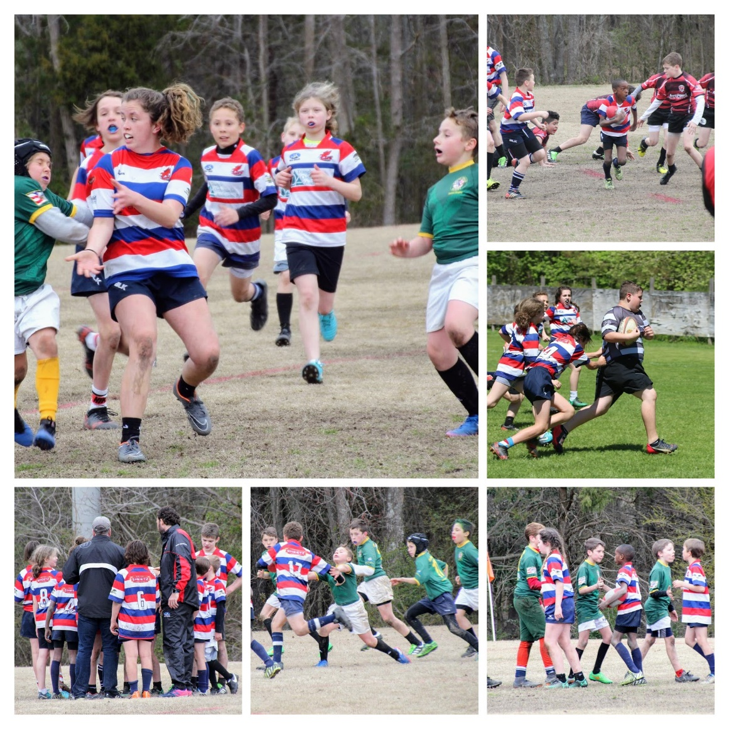
Raleigh RedHawks 2018 Season Review
Byron's 5/6 Program

Slide 14
Raleigh RedHawks 2018 Season Review
High School State Champions

Slide 15
Raleigh RedHawks 2018 Season Review
U18 Elite South
U16 South Blue

Slide 16
Raleigh RedHawks 2018 Season Review
U16 South white
U18 South Open

Slide 17
Raleigh RedHawks 2018 Season Review
U18 Tri Stars
U14 US South White

Slide 18
Raleigh RedHawks 2018 Season Review
U14 US South Blue

Slide 19
Raleigh RedHawks 2018 Season Review
Summer Plans
JV All Star Team entered for RCT Atlanta June 22-24
Craig Everett to coach JV practices week of June 11-15th
Summer Sevens- Coaches Toby and Alex
Summer Camp June 14th with Craig Everett (Cardiff Blues)
Touch- Every Saturday 9-11 am at Baileywick Park (All welcome)
7s practices Tuesday/Thursdays 6-8:30 pm at Baileywick Park (Alex and Toby)

Slide 20
Raleigh RedHawks 2018 Season Review
Honoring our Graduating Seniors

Slide 21
Raleigh RedHawks 2018 Season Review
Tate Phillipson
Scholarship to play rugby at St Bonaventure

Slide 22
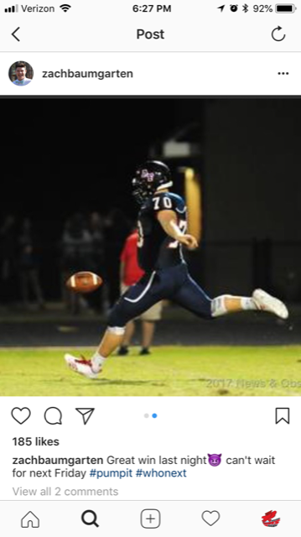
Raleigh RedHawks 2018 Season Review
Zack Baumgarten
ECU

Slide 23
Raleigh RedHawks 2018 Season Review
Brandon Johnson
Scholarship to play football at Clark Atlanta University

Slide 24
Raleigh RedHawks 2018 Season Review
Jackson Cranor
Enlisting in the army
We thank you for your service!

Slide 25
Raleigh RedHawks 2018 Season Review
Michael Baric
Will be attending UNC Wilmington

Slide 26
Raleigh RedHawks 2018 Season Review
Tomas Alvarez-Marchesini
Attending Wake Tech with plans to transfer to NC State.

Slide 27
Raleigh RedHawks 2018 Season Review
Evan Thomas
Will be attending Cardiff Metropolitan University on a rugby Scholarship

Slide 28
Raleigh RedHawks 2018 Season Review
AWARDS

Slide 29
Raleigh RedHawks 2018 Season Review
Coach of the Year:
Chris Travis

Slide 30
5/6 Awards
MVP:
Kayden Baker
Byrce Engelbrecht
Hannah Mitchell
Most Improved:
Davis Helmer

Slide 31
Middle School Awards
MVP:
Adam Laros
David Sanchez
John Sollers
Nathan Wastie
Jaylen Webster
Clubman:
James Mcloughlin

Slide 32
Raleigh RedHawks 2018 Season Review
JV Awards
MVP
Matthew Doyle
Cam Wilson
Clubman:
Kyle Hodges

Slide 33
Raleigh RedHawks 2018 Season Review
Varsity Awards
MVP:
Nate Roeback
Kris Thomas
Clubman:
Christian Dickens

